Slide 1
Winter 25 Training
MCAP Assessments
Division of Assessment and Accountability
October 21, 2025 and October 22, 2025
MSDE and Pearson

Slide 2
Presentation Outline
Introductions and Welcome
Winter 2025 Administration
Launchpad
Accommodations
ADAM
Support
Wrap-up and Closing Remarks

Slide 3
Introductions and Welcome

Slide 4
Introductions and Welcome
Introductions and Welcome
Pearson
MSDE

Slide 5
Winter 2025 Administration
Winter 25 Administration Dates
Winter 25 Reporting Dates

Slide 6
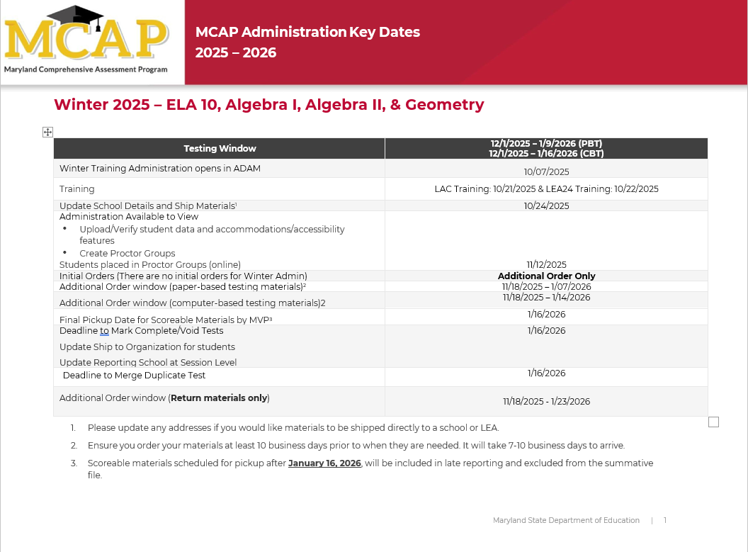
Winter 2025 Administration Dates
Winter 2025 Administration
Winter Testing Window:
12/01/2025 - 1/09/2026 (PBT)
12/01/2025 - 01/16/2026 (CBT)
Administration Available to View: 11/12/2025
Disclaimer:
Please be advised that administration dates are subject to change due to unforeseen delays or disruptions. The Maryland State Department of Education (MSDE) reserves the right to modify these dates as circumstances warrant.
https://support.mdassessments.com/training-resources/

Slide 7
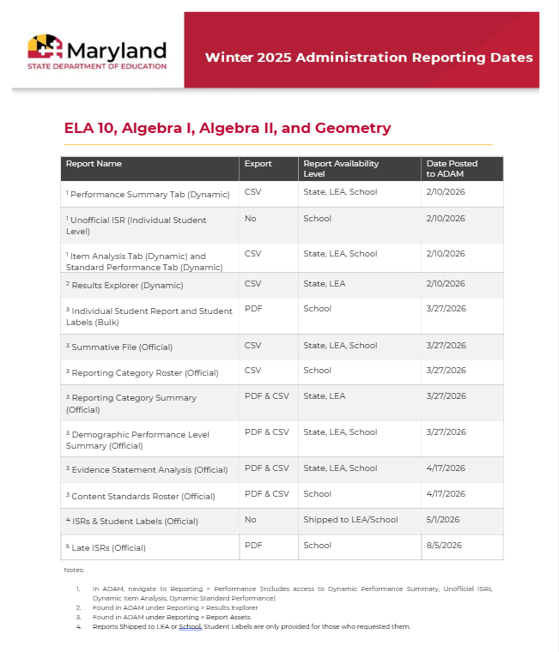
Winter 2025 Reporting Dates
Winter 2025 Administration
NOTE: Final Pickup date for Scorable
Materials is 1/16/2026. Materials picked up by MVP after 1/16/2026 will be included in
late reporting and excluded from the
Summative File.
Reports are routinely scheduled for release by 6:00 PM EST, though early availability is possible."
Disclaimer:
Please be advised that reporting dates are subject to change due to unforeseen delays or disruptions in the administration. The Maryland State Department of Education (MSDE) reserves the right to modify these dates as circumstances warrant.
https://support.mdassessments.com/reporting/
Notes:
Stress that a new summative file will NOT be generated to include those in late reporting.

Slide 8
Getting Started

Slide 9
Administration Requirements
Getting Started
Rostering
Registration
Administration
Reporting
  Students
  STCs
  Reporting Administrators
  Manage Student Transfers (LAC Only)
  Tagging (High school assessments only)
  Accommodations
  Additional Order
  Proctor Groups
  Update Reporting Orgs
  Update Ship to Org

Slide 10
Launchpad
What’s New
New Role
Importing Student Users
Importing Non-Student Users
Transfer Requests

Slide 11
What’s New
Launchpad
Roles
Required Fields
Student Import Updates
Updated Error message
Transfer Requests
Welcome Emails

Slide 12
Roles
Launchpad
Local Accountability Coordinator (LAC)
School Test Coordinator (STC)
District Reporting Administrator (NEW)
Report Administrator
Test Administrator (If applicable)
*NOTE: District Reporting Administrators will have access to PII

Slide 13
Required Fields
Launchpad
SASID
Grade
School/Organization
Date of Birth
Gender
Race
Ethnicity
IEP
Limited English Proficiency
Section 504
Local ID
Economic Disadvantage
*NOTE: Temporary SASIDs are not allowed.
Notes:
Before importing the file make sure all the required fields entered based on the vendor field definitions.

Slide 14
New Fields
Launchpad
New Fields on Student Import in Launchpad (Not Required)
preferredGivenName
preferredMiddleName
preferredLastName
pronouns

Slide 15
Current Field Updates
Launchpad
Updates to current fields on Import (Valid Values)
LEP Reading Exempt
Y, N, or Blank
Home LEA for LEA24
1-24, 30, 32, 66, Blank
*Note: LEA24 will need to capture a number in this field.

Slide 16
Primary Disability Type
Launchpad
Updates to Current Fields on Import – Primary Disability Type
AUT = Autism
DB = Deaf-blindness
DD = Developmental delay
EMN = Emotional disturbance
HI = Hearing impairment
ID = Intellectual disability
MD = Multiple disabilities
OI = Orthopedic impairment
OHI = Other health impairment
SLD = Specific learning disability
SLI = Speech or language impairment
TBI = Traumatic brain injury
VI = Visual impairment
Blank = Not specified

Slide 17
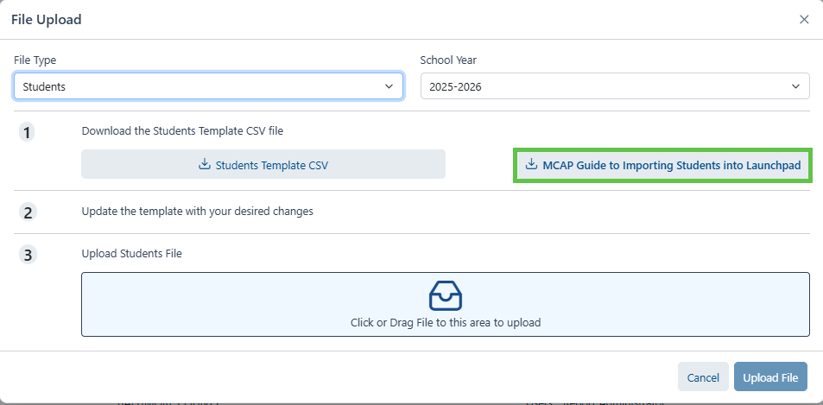
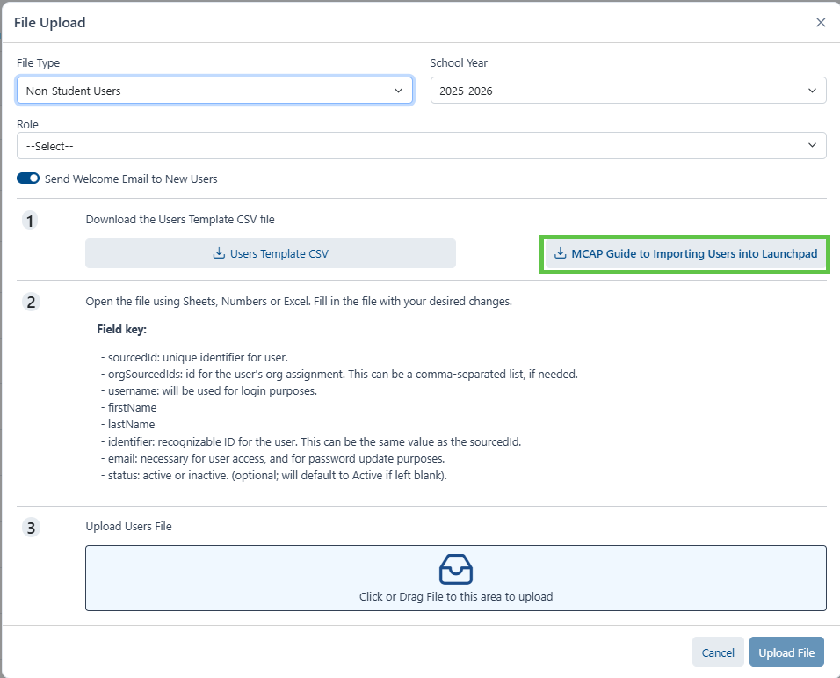
Guide to Importing Users
Launchpad
Now available from the file upload screen
You can now pull the guide from the upload screen itself as well as the MCAP Portal.

Slide 18
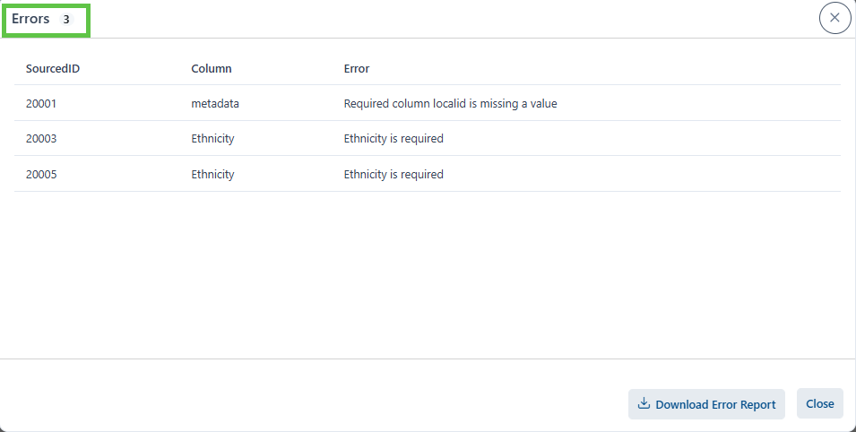
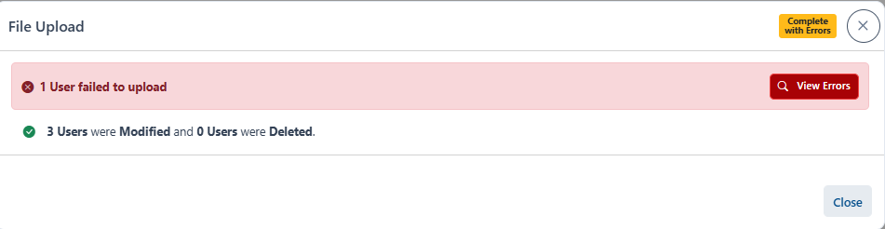
Update to Error Message
Launchpad
Error message in Launchpad is clear and concise
Notes:
Indicates Sourced ID Column and what the error is.

Slide 19
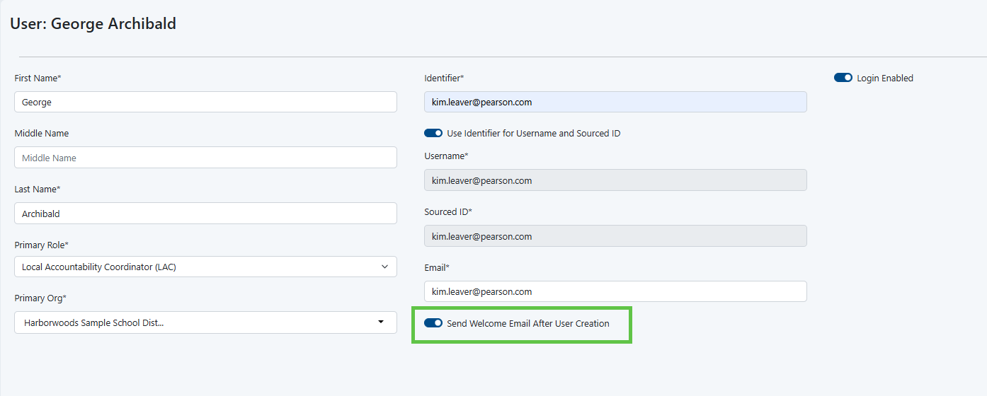
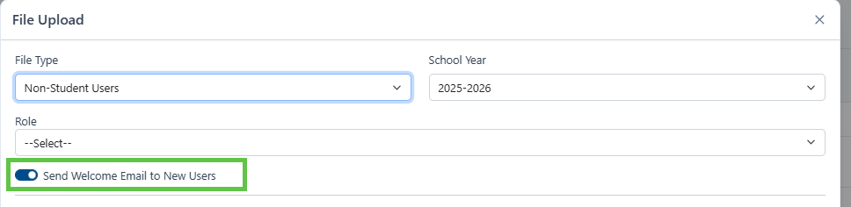
Welcome Emails
Launchpad
You can now choose to send a welcome email to a user upon creation, either through the UI or via import
*Note: Welcome Emails will come from: noreply@mail.launchpad.pearson.com

Slide 20
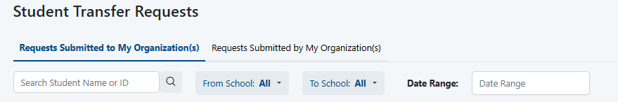
Search Transfer Requests
Launchpad
There is now a search bar to easily find Transfer requests

Slide 21
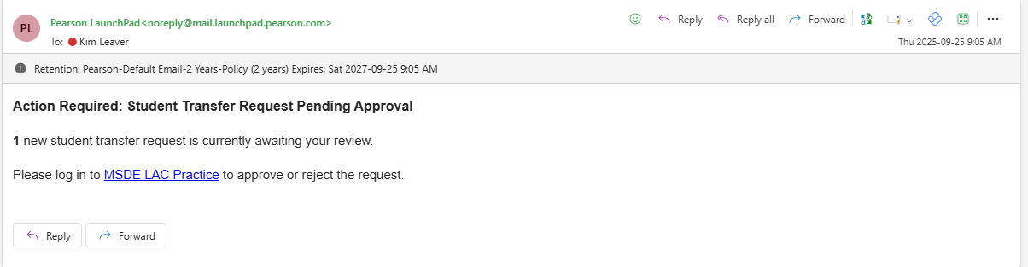
Transfer Requests Email Notification
Launchpad
Email notifications will be generated when transfer is initiated to transfer student from LEA to LEA.
Email will come from: noreply@mail.launchpad.pearson.com

Slide 22
Accommodations & Assignment Tags

Slide 23
Purpose
Accommodations & Accessibility Features
Assign Form-Driven Accommodations/Accessibility Features
Ensures students receive the correct test form aligned with their needs.
Enable Embedded Tools in TestNav
Example: Color contrast, text-to-speech, and other accessibility tools.
Support Initial Order Counts
Accommodations entered before the initial order window help determine accurate material counts.

Slide 24
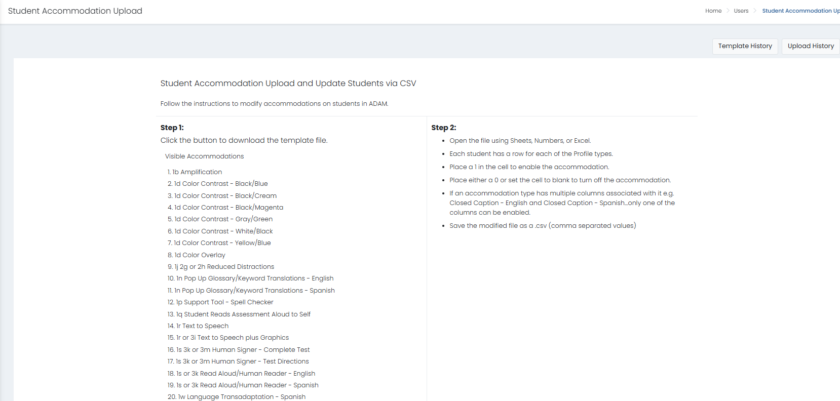
Assigning Accommodations – Import
Accommodations & Accessibility Features

Slide 25
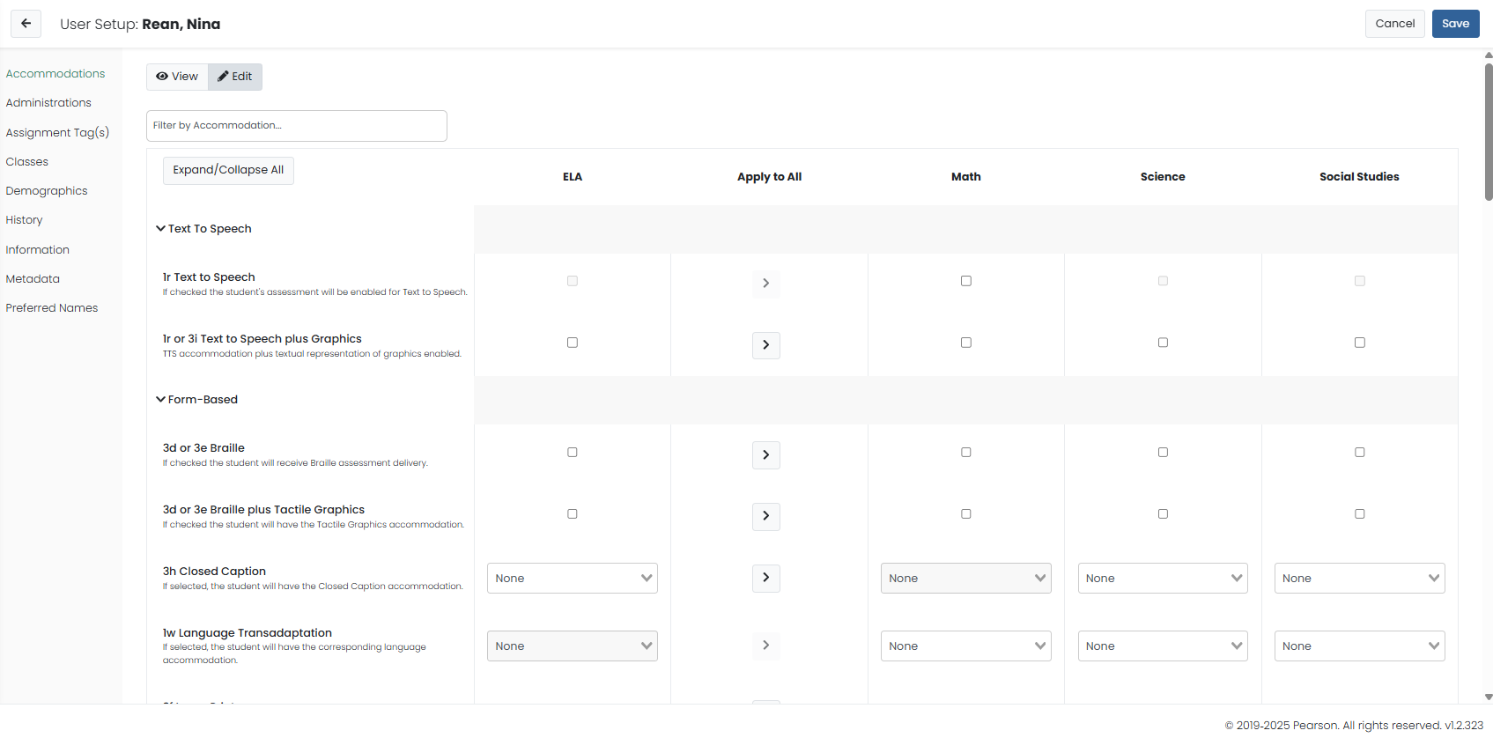
Assigning Accommodations – User Interface
Accommodations & Accessibility Features

Slide 26
Form Driven – Online part 1
Accommodations & Accessibility Features
 | ELA | Math | Science/Social Studies
ASL | X | X | X
Assistive Technology – Screen Reader | X | X | X
Assistive Technology (Non-screen reader) | X | X | X
Closed Caption | X |  | X
Human Reader | X | X | X
Human Signer | X | X | X
Text-to-Speech (TTS) | X | X (Text Only & Text + Graphics) | X
Spanish Online |  | X | X
Spanish Human Reader |  | X | X
Notes:
ELA/L, Science, and Social Studies will show the option of Text + Graphics because these forms are only published in this format.
Mathematics is the only content that is published with both options:
Text Only (TX) will read the text on the screen.
Text + Graphics (GR) will read the text and graphics on the screen.

Slide 27
Form Driven – Online part 2
Accommodations & Accessibility Features
ADAM Accommodations Upload
 | 1s 3k or 3m Human Signer - Complete Test Mathematics/Science, Social Studies | 1s 3k or 3m Human Signer - Test Directions | 1s or 3k Read Aloud/Human Reader - English | 1s or 3k Read Aloud/Human Reader - Spanish
 | Column X | Column Y | Column Z | Column AA
1s - Human Reader or Human Signer for Math, Science, and Social Studies (Available in English and Spanish | X |  | X | X
3k Human Reader/Human Signer for ELA/L |  |  | X
3m - Human Signer for Test Directions |  | X
MAAAM
Notes:
ELA/L, Science, and Social Studies will show the option of Text + Graphics because these forms are only published in this format.
Mathematics is the only content that is published with both options:
Text Only (TX) will read the text on the screen.
Text + Graphics (GR) will read the text and graphics on the screen.

Slide 28
Text-to-Speech (1r) – Math, Science, and Social Studies (MAAAM, p. 24)
Accommodations & Accessibility Features
Students that do not meet criteria for Appendix D but struggle with the readability of content in the areas of math, science and social studies may benefit from TTS.
A student should have experience with the use of TTS during instruction and there should be data and/or observations to indicate that there is benefit from the use of this accessibility feature.
Students with IEP or 504 plans that have met the criteria for Appendix D may also use the accommodation of TTS in ELA (3i).
Maryland Assessment, Accessibility, and Accommodations Manual, August 2025, p. 24
https://www.marylandpublicschools.org/programs/Documents/Special-Ed/IEP/MAM508102017.pdf
Notes:
ELA/L, Science, and Social Studies will show the option of Text + Graphics because these forms are only published in this format.
Mathematics is the only content that is published with both options:
Text Only (TX) will read the text on the screen.
Text + Graphics (GR) will read the text and graphics on the screen.

Slide 29
Text-to-Speech (3i) – ELA/L (MAAAM, p. 42)
Accommodations & Accessibility Features
The purpose of the embedded text-to- speech accommodation is to provide access to printed or written texts in ELA/L for a very small number of students with print disabilities who would otherwise be unable to participate in instruction or assessment because their disability severely limits their ability to access print.
In making decisions on whether to provide the student with this accommodation, IEP teams and 504 Plan Coordinators are instructed to consider whether the student has:
Blindness or a visual impairment and has not yet learned (or is unable to use) braille OR
A disability that severely limits or prevents them from accessing printed text, even after varied and repeated attempts to teach the student to do so (e.g., student is unable to decode printed text);
When determining the need for this accommodation, it is important to consider the purpose of the tests the student will be taking and the skills the test is intending to measure so that it can be determined how the accommodation might affect the results.
Maryland Assessment, Accessibility, and Accommodations Manual, August 2025, p. 42
https://www.marylandpublicschools.org/programs/Documents/Special-Ed/IEP/MAM508102017.pdf
Notes:
ELA/L, Science, and Social Studies will show the option of Text + Graphics because these forms are only published in this format.
Mathematics is the only content that is published with both options:
Text Only (TX) will read the text on the screen.
Text + Graphics (GR) will read the text and graphics on the screen.

Slide 30
Accommodations – Paper
Accommodations & Accessibility Features
 | ELA | Math | Science/Social Studies
Paper | X | X | X
Spanish Paper |  | X | X
Read Aloud | X | X | X
Spanish Read Aloud |  | X | X
Human Signer | X | X | X
Large Print | X | X | X
Spanish Large Print |  | X | X
Braille | X | X | X

Slide 31
ADAM Accommodation Hierarchy
Online Form Assignment Order
Braille Tactile Graphics
Closed Caption
American Sign Language (ASL)
Text to Speech (TTS)
Read Aloud/Human Reader
Human Signer
Assistive Technology (Screen Reader)
Assistive Technology (Non-Screen Reader)
Paper Form Assignment Order
Paper
Large Print
Braille Tactile Graphics
Read Aloud/Human Reader
Human Signer
Notes:
Per the MAAAM, the accommodation the student is most accustomed during instruction and throughout the academic year is the accommodation that should be assigned to the student. It is ill advised that students should be assigned TTS (as a backup) when human reader is not available. STCs should ensure TTS as an alternative to HR is specified in the IEP/504/ML plan. If you select both, the STC must place an additional order request since TTS will supersede HR.

Slide 32
Assignment tags
ADAM
Assignment Tags will need to be added to all students taking High School Assessments
ELA10
Algebra I
Algebra II
Geometry
If tag is not added to the student, they will not appear in the administration.
*NOTE: Assignment tags must be added to paper students as well. Failure to add a tag for PBT or inadvertently removing the tag will cause a scoring and reporting delay. These students will appear in late reporting and will not be included in your summative file.

Slide 33



Proctor Group Updates
Efficiency
Test Security
User Interface

Slide 34
Proctor Groups
Proctor Group Updates
Default Proctor Groups in ADAM will no longer be created by Pearson
Ability to place transfer students into new proctor group
From School A to School B within the same LEA
From School A to School B from LEA to LEA

Slide 35
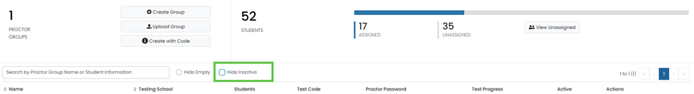
Hiding Proctor Groups
Proctor Group Updates
Ability to hide inactive Proctor Groups.

Slide 36
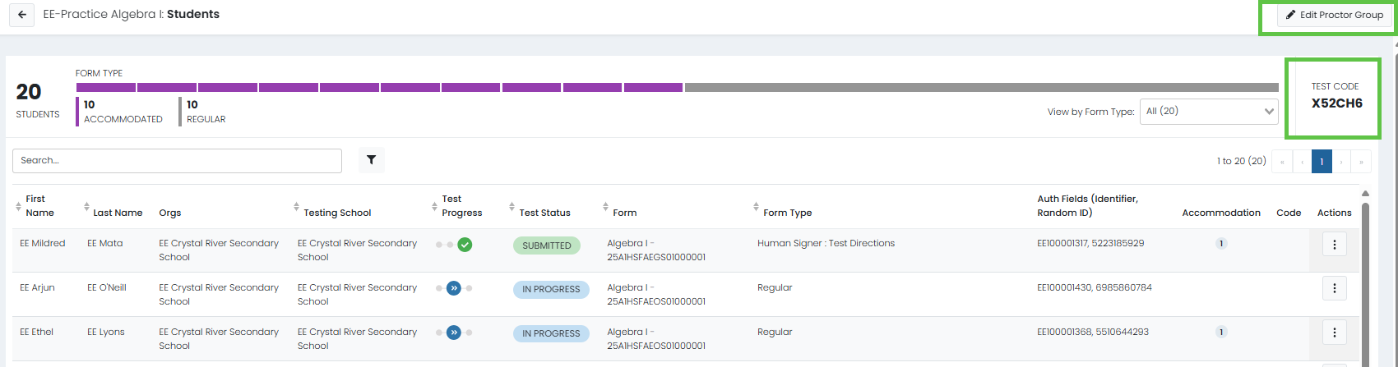
Proctor Group Button
Proctor Group Updates
Edit Proctor Group button and Test Code indicator moved on Student's page under Proctor Groups
Notes:
Visual Appeal
Easy of Use
??

Slide 37
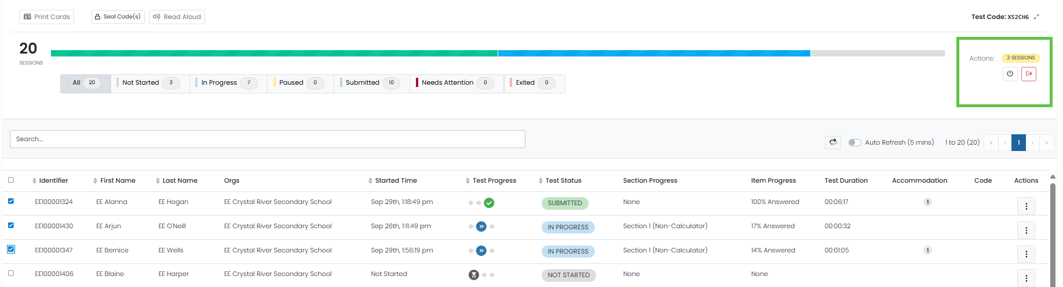
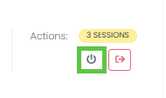
Moving Students Forward
Proctor Group Updates
Ability to select students to move forward in a proctor group instead of all or one at a time.
There are now boxes next to the students within a proctor group that allows you to select only the students you would like to move to a section or submit section.

Slide 38
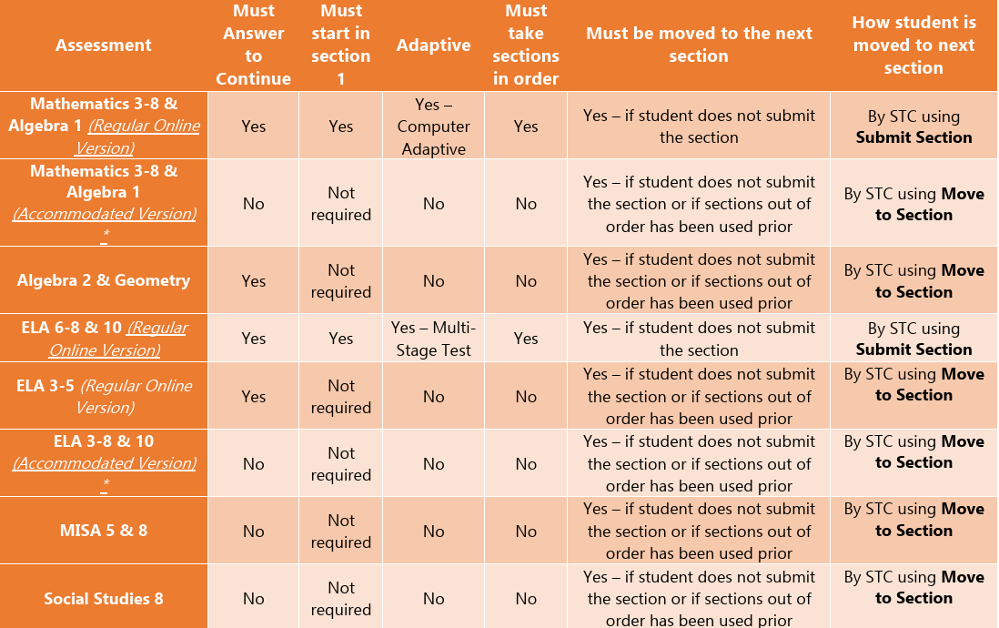
Administration Cheat Sheet
Proctor Group Updates
The administration cheat sheet is provided in the TCM for quick reference and posted on the MCAP portal.

Slide 39
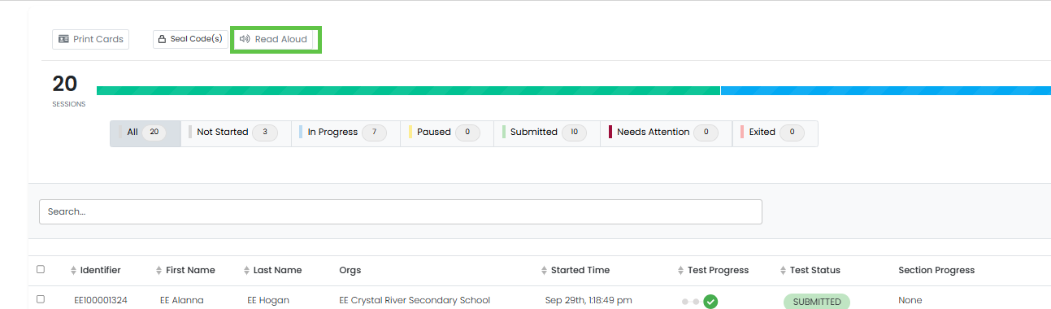
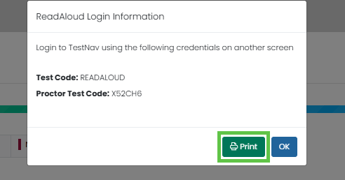
Read Aloud
Proctor Group Updates
Read aloud Login information is now printable

Slide 40
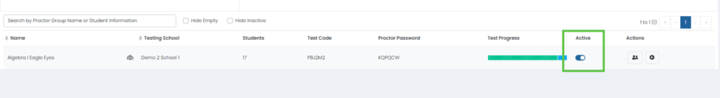
Locking Proctor Groups
Proctor Group Updates
When testing is not taking place, STCs & LACs can lock proctor groups individually. Once this switch is toggled it will deactivate the proctor group until the proctor is ready to resume testing.
Notes:
This feature was enabled post manual approval for the TCM.

Slide 41
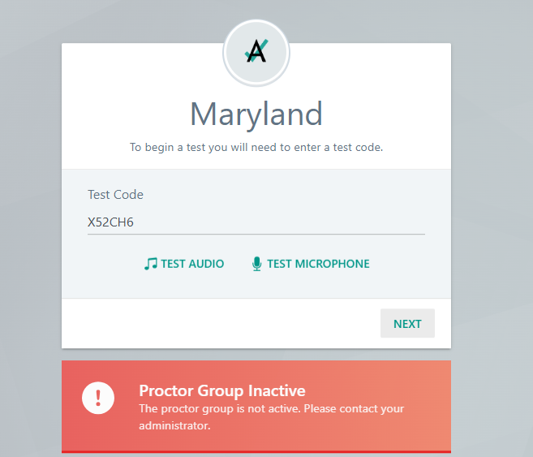
Locking Proctor Groups (Student)
Proctor Group Updates
If a student tries to log in it will tell the student that the test session is no longer active. If the proctor group is then set to active it will now work fine.

Slide 42
ADAM – Administration
Print Cards
Accountability Codes

Slide 43
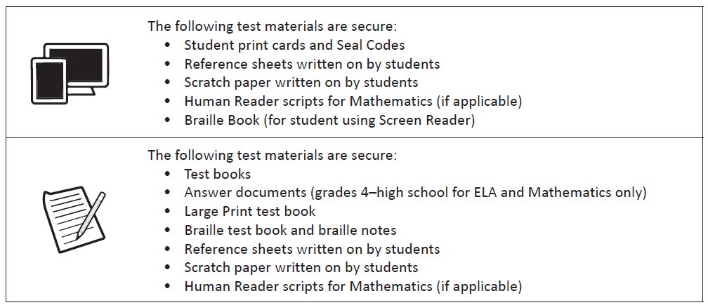
Administration – Secured Testing
ADAM – Administration
*Provide only one Seal Code at a time as directed in the computer-based test script.

Slide 44
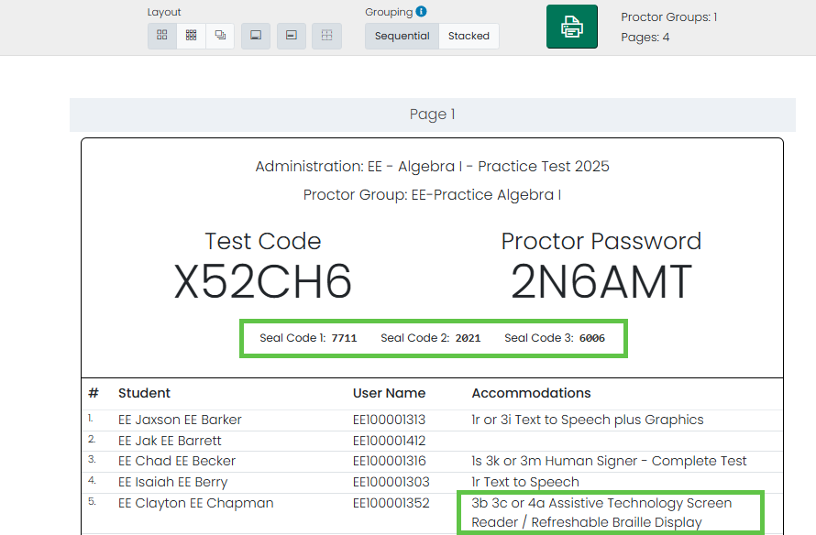
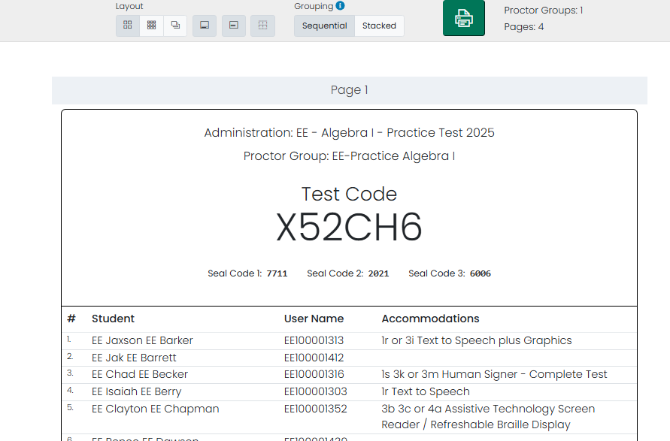
Print Cards part 1
ADAM
Updates to Print Card
Seal Codes added to proctor roster page
Proctor Print Card Screen - Default to Wrapping Accommodations on Roster
Notes:
Visual Appeal
Easy of Use
??

Slide 45
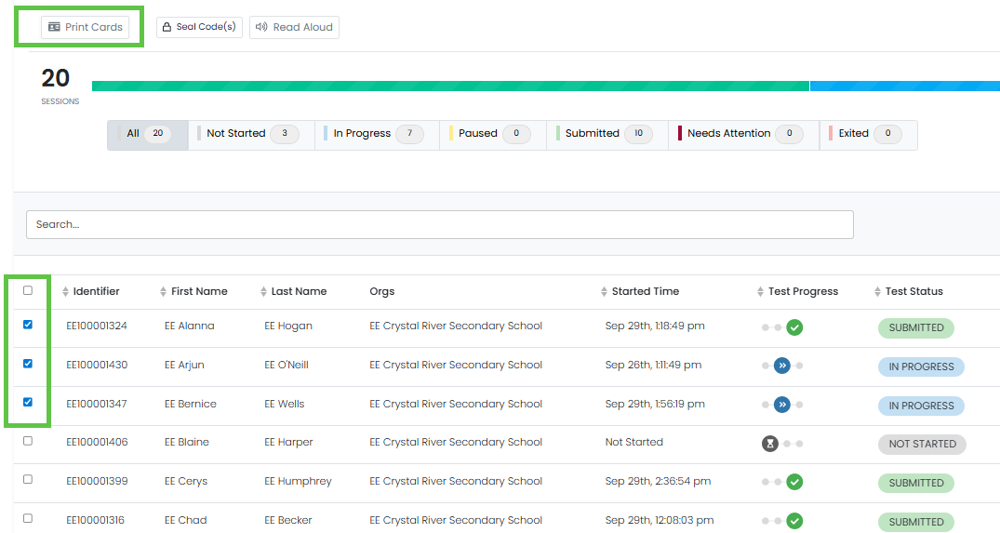
Print Cards part 2
ADAM
Updates to Print Card
Will be able to select which Print Cards to print in a Proctor Group.
Notes:
Visual Appeal
Easy of Use
??

Slide 46
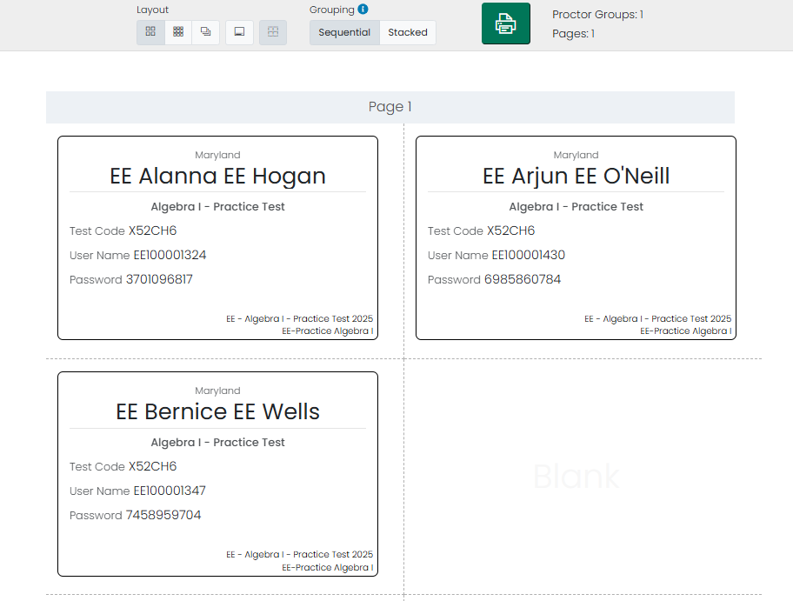
Print Cards part 3
ADAM
Will be able to select which Print Cards to print in a Proctor Group.
Notes:
Visual Appeal
Easy of Use
??

Slide 47
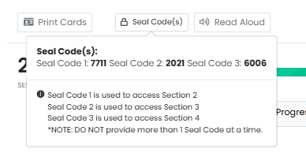
Seal Codes
ADAM
You will now see a direction message when you click on the Seal Code button
Notes:
Visual Appeal
Easy of Use
??

Slide 48
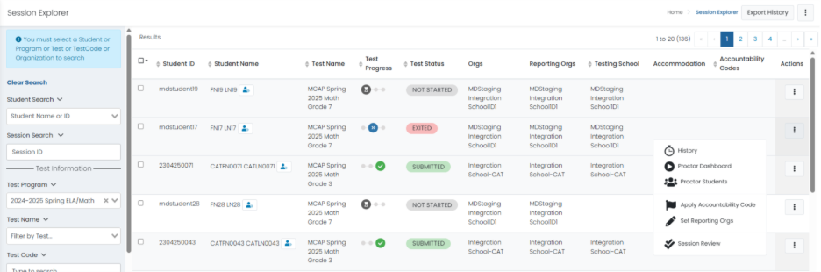
Student Details – Session Explorer
ADAM
Access to student page from Session Explorer - Currently can access proctor dashboard but not the student details

Slide 49
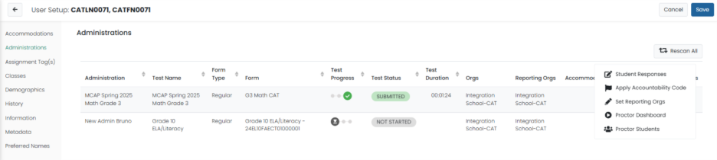
Student Details – User Screen
ADAM
Access to student page from User screen - Currently can access proctor dashboard but not the student details.

Slide 50
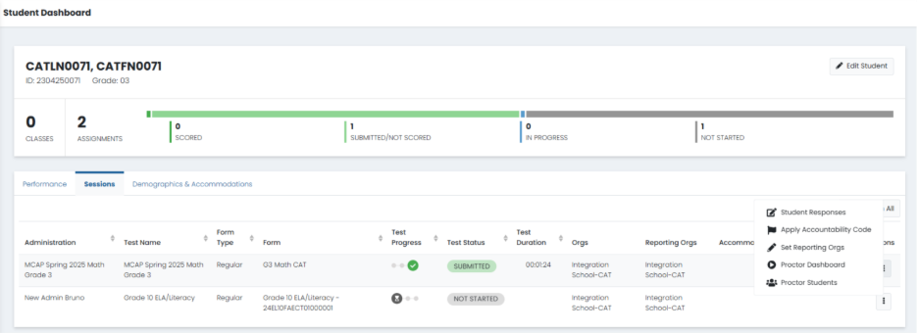
Student Details – Student Dashboard
ADAM
Access to student page from Student Dashboard - Currently can access proctor dashboard but not the student details.

Slide 51
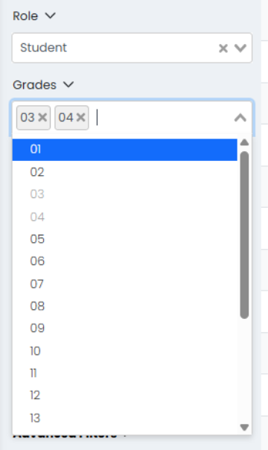
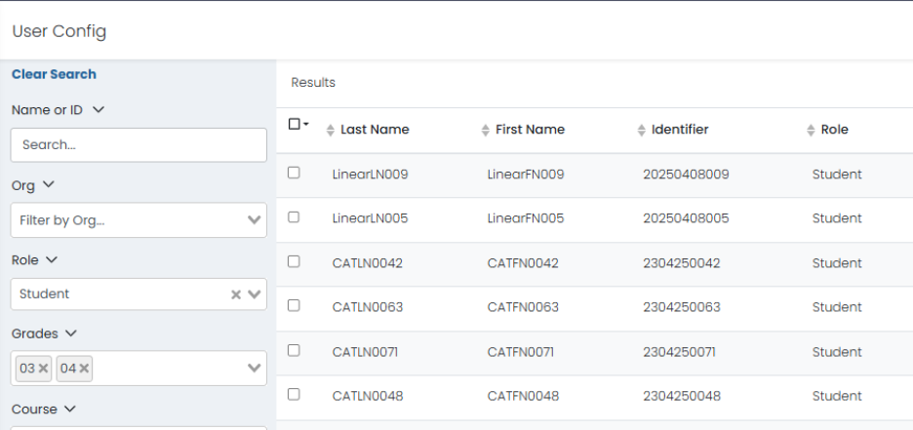
Multiple Grades
ADAM
Search and export for multiple grades in ADAM – in ADAM Rostering > Users

Slide 52
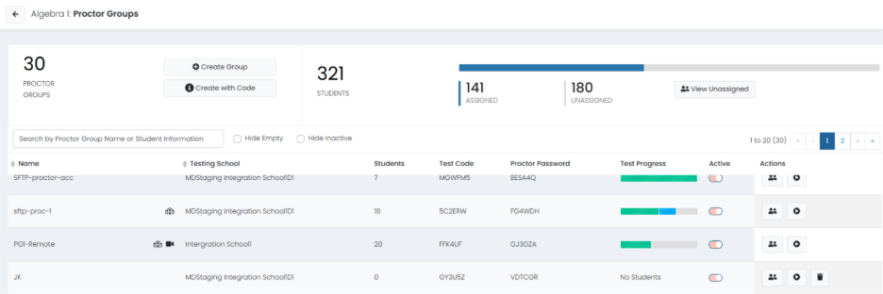
Column Headers
ADAM
Column Headers in Proctor Dashboard are Frozen!

Slide 53
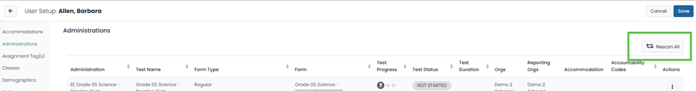
Administration Cards
ADAM
Real-Time Updates in ADAM: Changes made to a student’s administration card (e.g., accommodations) in ADAM now update immediately.
Student Scanning Functionality: Scanning a student in ADAM triggers a near real-time update when changes are made through the user interface.
Notes:
Auto rescan is still every 30 minutes, BUT…….you don’t have to wait. Click the rescan to force the rescan.

Slide 54
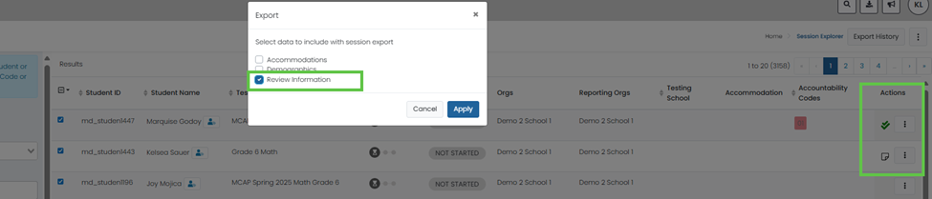
Session Review
ADAM
Session Review information can now be selected to be pulled into an export in Session Explorer.
Notes:
Efficiency
Efficiency (addressed an issue)

Slide 55

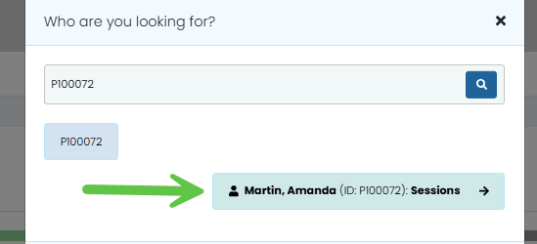
Accessing Student Dashboard
ADAM
Access Student Dashboard by clicking the magnifying glass in the top right-hand corner
You can enter the Student name or SASID to search --> Click on student
Notes:
Efficiency and Visual

Slide 56
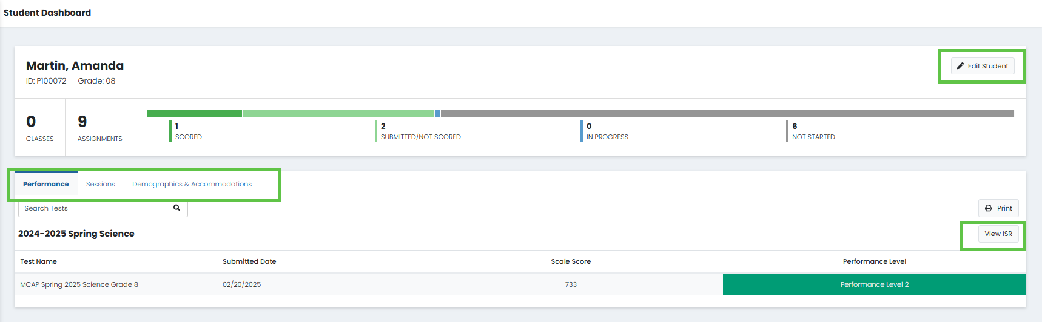
Expanded Student View Options
ADAM
From the designated screen, users can access: Performance, Session Details, Demographics, Accommodations, View ISR (Individual Student Report), Edit Student – which redirects to the User Setup page.
.
Notes:
Add in a Demo Slide

Slide 57
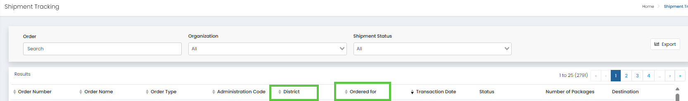
Tracking Shipments
ADAM
Enhanced Shipment Tracking:
Orders now display both the District and the specific School they were ordered for, improving visibility and tracking accuracy.
Notes:
Efficiency and Visual

Slide 58
Accountability Codes
ADAM
Accountability codes in ADAM have been reduced to four (4).
01 – Medical Emergency
02 – Incorrect Accommodation/ Accessibility Feature
03- Other
04 – Cheating/ Using Unauthorized Electronic Device - "Retest Not Allowed"
*Note: Codes 1-3 will void and allow new session. Code 4 will void and not allow a new session to be created.
*Only an LAC can apply Accountability codes in ADAM

Slide 59
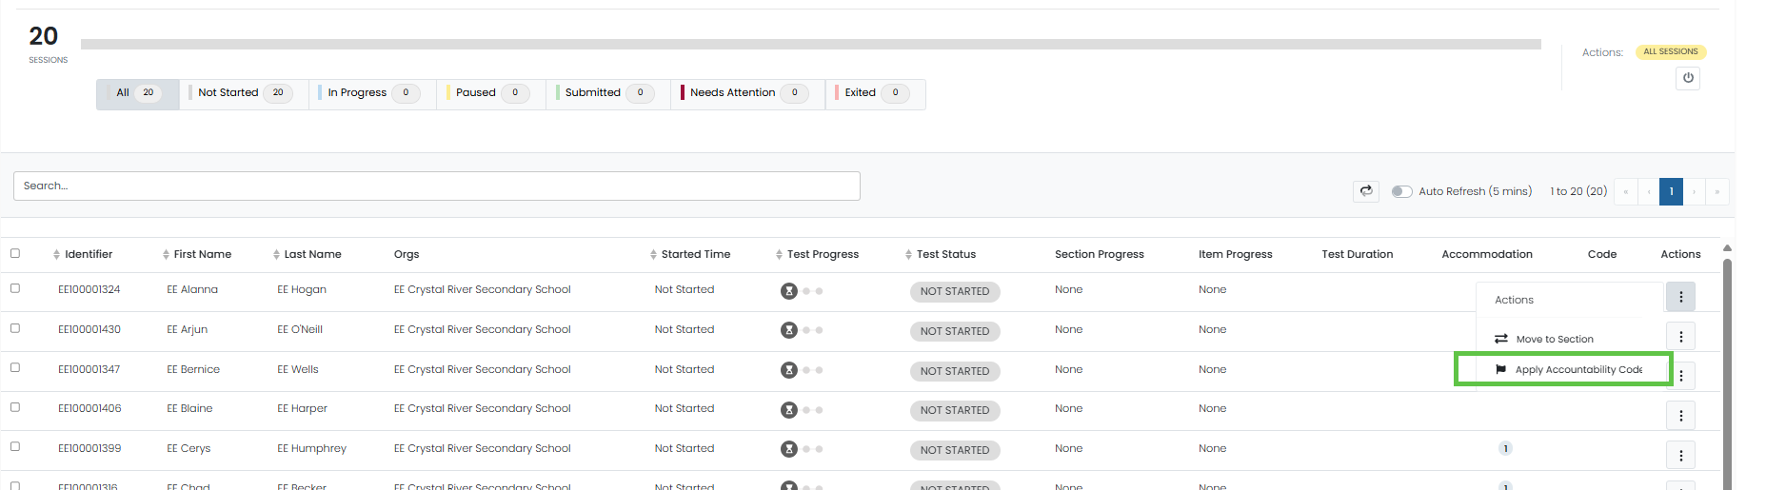
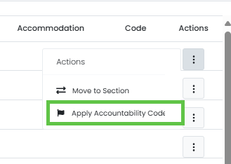
Adding Accountability Codes
ADAM
Accountability codes can now be added via the proctor dashboard
Immediate Session Start
Using an accountability code to void and allow a new session will now take effect instantly—no need to wait for an admin rescan.

Slide 60
Reporting
Efficiency
Test Security
User Interface

Slide 61
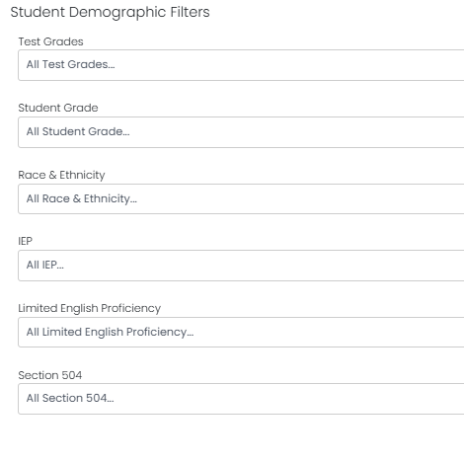
New Role
Reporting
District Reporting Administrator – New Role
Will have access to PII (User page under Rostering)
Will be able to Filter reports by the following
Demographics.
NOTE:
You will not find this new role in the manuals

Slide 62
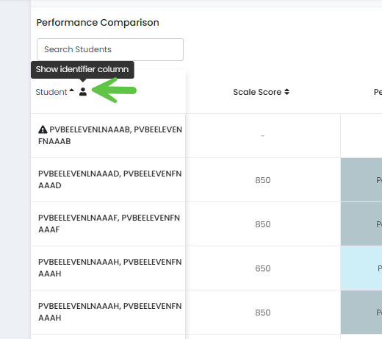
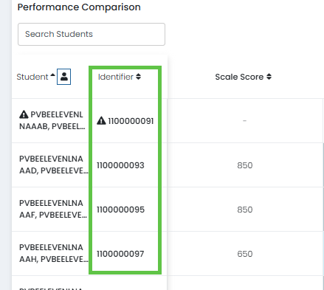
Performance Reports – SASID
Reporting
SASIDs are now visible in Performance Reports and will appear on CSV exports.

Slide 63
RCR, RCS, DPLS
Reporting
The following reports will now be dynamic and can be accessed in Performance Reports.
Reporting Category Roster (RCR)
Reporting Category Summary (RCS)
Demographic Performance Level Summary (DPLS)
The PDF will no longer be available. Legacy PDFs will remain available in Report Assets.

Slide 64
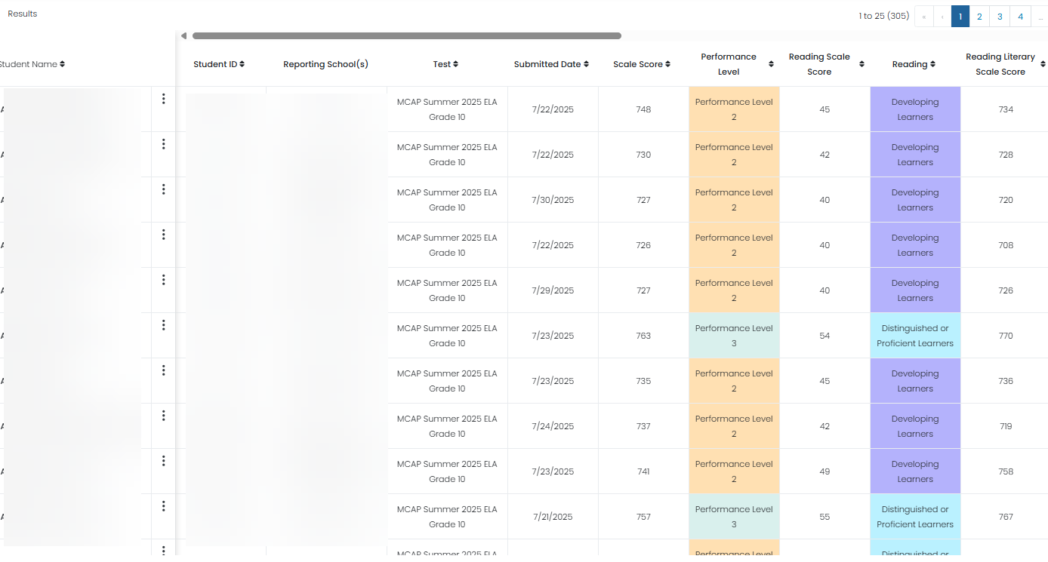
Reporting Category Roster (RCR)
Performance Reports
This information will now be available in Reporting > Results Explorer
Reporting School is now available!

Slide 65
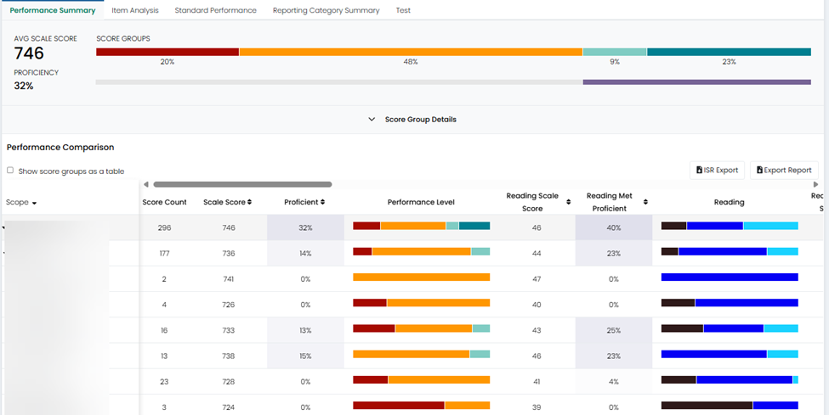
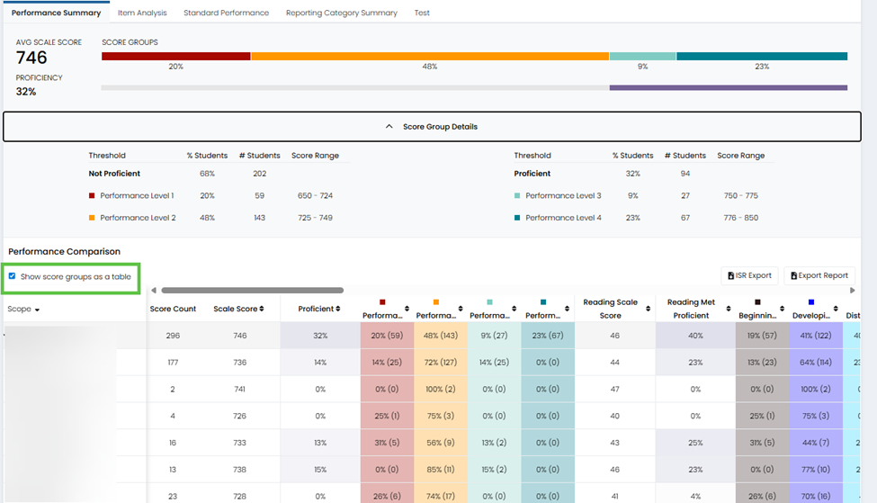
Reporting Category Summary (RCS)
Performance Reports
This information will now be available in Reporting > Performance

Slide 66
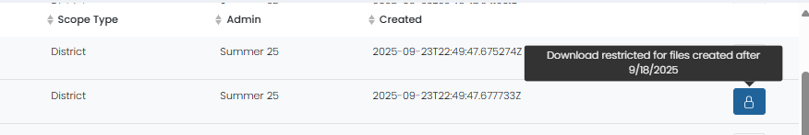
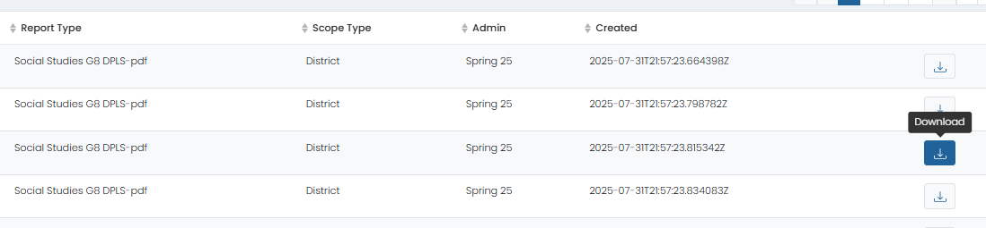
Report Assets Availability
Performance Reports
Report Assets will be locked while Pearson is validating prior to posting.
You will see a closed padlock when they are locked for viewing.
Once validated you will see they are ready for you to view by seeing the download arrow.

Slide 67
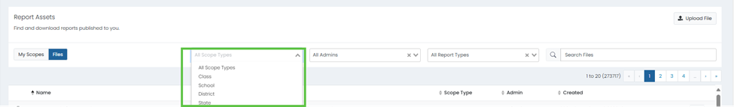
Report Assets (Scope)
Performance Reports
Files in Report Assets can now be searched by scope type, School, District, and State.

Slide 68
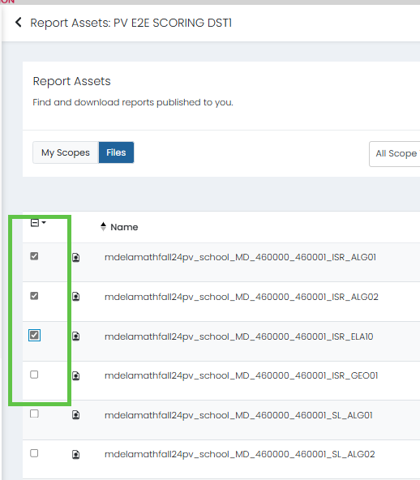

Report Assets (Bulk Download)
Performance Reports
Ability to select multiple reports to zip.

Slide 69


Report Assets
Performance Reports
Zip Reports Continued
Once downloaded all reports will be zipped together.

Slide 70
Support

Slide 71

New MCAP Portal
Support
https://support.mdassessments.com/

Slide 72


Customer Support part 1
Support
Contact Customer Support via Phone or Chat via the MCAP Portal.
Support | MD Portal

Slide 73
Customer Support part 2
Support
When reaching out to Customer Support please be prepared to provide the following information.
LAC/STC Name
LAC/STC Email/Phone Number
LEA/School Name
Content Area/Assessment Name
Question/Inquiry
Description:
  SASID, Proctor Group name, Admin card title, Grade
  Device Type, Platform (Chrome, IOS), Log Files, SASID

Slide 74

Customer Support - Technical
Support
You can also reach out to our Field Service Engineers for help with TestNav set up.
Support | MD Portal

Slide 75
Customer Support - TestNav
Support
Verify that devices meet requirements
Pearson does not recommend software or technology changes during an online testing administration.
Pearson will allow students to test with unsupported OS(unless it is blocked for security purposes).
However, Pearson cannot confirm the testing experience with the unsupported OS.
TestNav System Requirements

Slide 76
Next Steps

Slide 77

Training Administration – Non-Secure (MCAP Portal)
Next Steps
Non-Secure Practice tests can be found on the MCAP Portal
Practice Tests | MD Portal

Slide 78

Training Administration – HIGHLY RECOMMENDED
Support
Notes:
Training Admins are used to practice everything discussed earlier!
PRACTICE! PRACTICE! PRACTICE!
Training Administration Available - 10/07/2025
Training Admins are used to
Creating Proctor Groups
Adding assignment Tags
Updating Accommodations
Provide students access to take online practice tests to prepare for the upcoming administration.

Slide 79
Training Administration – LAC Practice Site
Support
The MSDE LAC Practice site has been updated.
Each LAC will now:
Have access to their own set of data.
1 District
2 Schools
Demo Students
LACs will need to provide access to STC's
*NOTE: All LACs will be given a new sign on after Winter Training has completed.

Slide 80
Wrap-up and Closing Remarks
Questions

